Slide 1
Apriori Algorithm
Mining Association Rules

Slide 2
Outline
Basic concepts
Apriori algorithm

Slide 3
Association rule mining
Proposed by Agrawal et al in 1993.
It is an important data mining model studied extensively by the database and data mining community.
Assume all data are categorical.
Initially used for Market Basket Analysis to find how items purchased by customers are related.
Bread → Milk [sup = 5%, conf = 100%]
Notes:
Support (sup = 5%): 5% of all transactions in the dataset contain both Bread and Milk.

Slide 4
The model: data
I = {i₁, i₂, …, i_{m}}: a set of items.
Transaction t :
  t a set of items, and t ⊆ I.
Transaction Database T: a set of transactions T = {t₁, t₂, …, t_{n}}.

Slide 5
Transaction data: supermarket data
Market basket transactions:
  t1: {bread, cheese, milk}
  t2: {apple, eggs, salt, yogurt}
  … …
  tn: {biscuit, eggs, milk}
Concepts:
  An item: an item/article in a basket
  I: the set of all items sold in the store
  A transaction: items purchased in a basket; it may have TID (transaction ID)
  A transactional dataset: A set of transactions

Slide 6
Transaction data: a set of documents
A text document data set. Each document is treated as a “bag” of keywords
doc1: Student, Teach, School
doc2: Student, School
doc3: Teach, School, City, Game
doc4: Baseball, Basketball
doc5: Basketball, Player, Spectator
doc6: Baseball, Coach, Game, Team
doc7: Basketball, Team, City, Game

Slide 7
The model: rules
Given a set of transactions, find rules that will predict the occurrence of an item based on the occurrences of other items in the transaction
A transaction t contains X, a set of items (itemset) in I, if X ⊆ t.
An association rule is an implication of the form:
X → Y, where X, Y ⊂ I, and X ∩Y = ∅
An itemset is a set of items.
  E.g., X = {milk, bread, cereal} is an itemset.
A k-itemset is an itemset with k items.
  E.g., {milk, bread, cereal} is a 3-itemset
Notes:
Implication means co-occurrence, not causality!

Slide 8
Rule strength measures
Support: The rule holds with support sup in T (the transaction data set) if sup% of transactions contain X ∪ Y.
  sup = Pr(X ∪ Y).
Confidence: The rule holds in T with confidence conf if conf% of tranactions that contain X also contain Y.
  conf = Pr(Y | X)
An association rule is a pattern that states when X occurs, Y occurs with certain probability.
Notes:
Support count (σ)
Frequency of occurrence of an itemset
E.g. σ({Milk, Bread, Diaper}) = 2
Support
Fraction of transactions that contain an itemset
E.g. s({Milk, Bread, Diaper}) = 2/5
Frequent Itemset
An itemset whose support is greater than or equal to a minsup threshold

Slide 9
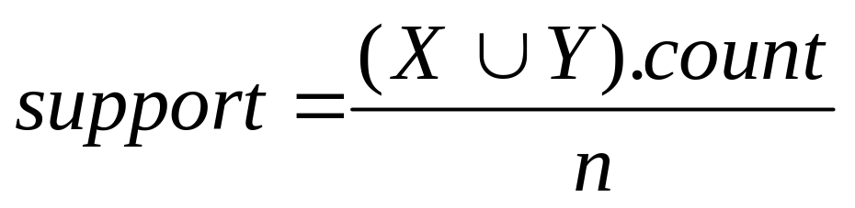
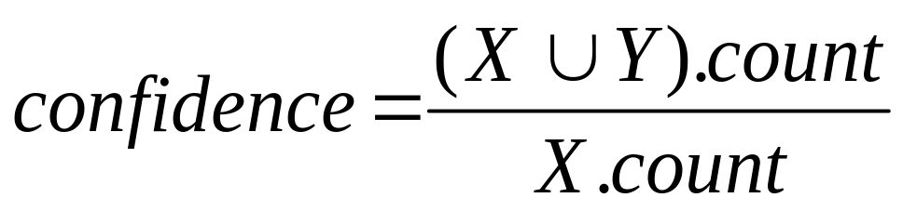
Support and Confidence
Support count: The support count of an itemset X, denoted by X.count, in a data set T is the number of transactions in T that contain X. Assume T has n transactions.
Then,
Notes:
Market-Basket transactions
Support count (σ)
Frequency of occurrence of an itemset
E.g. σ({Milk, Bread, Diaper}) = 2
Support
Fraction of transactions that contain an itemset
E.g. s({Milk, Bread, Diaper}) = 2/5
Frequent Itemset
An itemset whose support is greater than or equal to a minsup threshold

Slide 10
An example
  t1: Beef, Chicken, Milk
  t2: Beef, Cheese
  t3: Cheese, Boots
  t4: Beef, Chicken, Cheese
  t5: Beef, Chicken, Clothes, Cheese, Milk
  t6: Chicken, Clothes, Milk
  t7: Chicken, Milk, Clothes
Transaction data
Assume:
minsup = 30%
minconf = 80%
An example frequent itemset:
{Chicken, Clothes, Milk} [sup = 3/7]
Association rules from the itemset:
Clothes → Milk, Chicken [sup = 3/7, conf = 3/3]
… …
Clothes, Chicken → Milk, [sup = 3/7, conf = 3/3]
Notes:
Association Rule
An implication expression of the form X → Y, where X and Y are itemsets
Example:
{Milk, Diaper} → {Beer}
Support (s)
Fraction of transactions that contain both X and Y
Confidence (c)
Measures how often items in Y
appear in transactions that
contain X

Slide 11
Association Rule Mining Task
Given a set of transactions T, the goal of association rule mining is to find all rules having
  support ≥ minsup threshold
  confidence ≥ minconf threshold
Brute-force approach:
  List all possible association rules
  Compute the support and confidence for each rule
  Prune rules that fail the minsup and minconf thresholds
  ⇒ Computationally prohibitive!

Slide 12

Mining Association Rules
Example of Rules:
{Milk,Diaper} → {Beer} (s=0.4, c=0.67)
{Milk,Beer} → {Diaper} (s=0.4, c=1.0)
{Diaper,Beer} → {Milk} (s=0.4, c=0.67)
{Beer} → {Milk,Diaper} (s=0.4, c=0.67)
{Diaper} → {Milk,Beer} (s=0.4, c=0.5)
{Milk} → {Diaper,Beer} (s=0.4, c=0.5)
Observations:
All the above rules are binary partitions of the same itemset:
{Milk, Diaper, Beer}
Rules originating from the same itemset have identical support but
can have different confidence
Thus, we may decouple the support and confidence requirements

Slide 13
Many mining algorithms
There are a large number of them!!
They use different strategies and data structures.
Their resulting sets of rules are all the same.
  Given a transaction data set T, and a minimum support and a minimum confident, the set of association rules existing in T is uniquely determined.
Any algorithm should find the same set of rules although their computational efficiencies and memory requirements may be different.
We study only one: the Apriori Algorithm

Slide 14
The Apriori algorithm
Two-step approach:
  Frequent Itemset Generation
    Generate all itemsets whose support ≥ minsup
  Rule Generation
    Generate high confidence rules from each frequent itemset, where each rule is a binary partitioning of a frequent itemset
Frequent itemset generation is still computationally expensive
  E.g., a frequent itemset
  {Chicken, Clothes, Milk} [sup = 3/7]
  and one rule from the frequent itemset
    Clothes → Milk, Chicken [sup = 3/7, conf = 3/3]

Slide 15
Step 1: Mining all frequent itemsets
A frequent itemset is an itemset whose support is ≥ minsup.
Key idea: The apriori property (downward closure property): any subsets of a frequent itemset are also frequent itemsets
ABC ABD ACD BCD
AB AC AD BC BD CD
A B C D
Notes:
Apriori Property (Downward Closure Property):
If an itemset is frequent, then all of its subsets are also frequent.
This is the core idea that allows the Apriori algorithm to prune the search space efficiently.

Slide 16
The Algorithm
Iterative algo. (also called level-wise search): Find all 1-item frequent itemsets; then all 2-item frequent itemsets, and so on.
  In each iteration k, only consider itemsets that contain some k-1 frequent itemset.
Find frequent itemsets of size 1: F₁
From k = 2
  C_{k} = candidates of size k: those itemsets of size k that could be frequent, given F_{k-1}
  F_{k} = those itemsets that are actually frequent, F_{k} ⊆ C_{k} (need to scan the database once).
Notes:
Let k=1
Generate frequent itemsets of length 1
Repeat until no new frequent itemsets are identified
1. Generate candidate (k+1)-itemsets from frequent k-itemsets
2. Prune candidate (k+1)-itemsets containing some infrequent k-itemset
3. Count the support of each candidate by scanning the DB
4. Eliminate infrequent candidates, leaving only those that are frequent

Slide 17

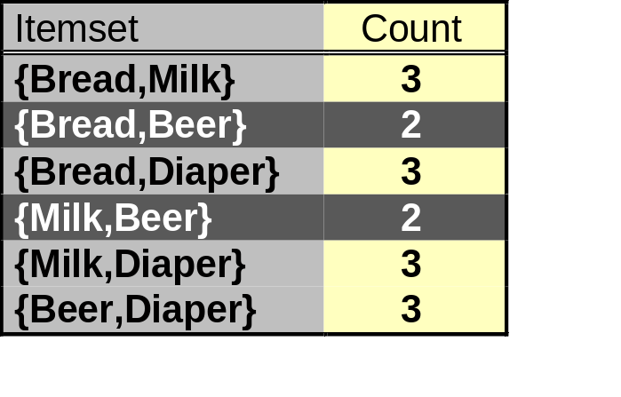
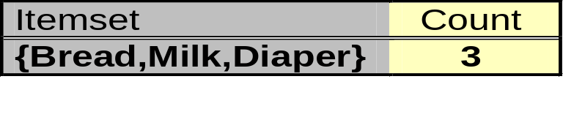
Illustrating Apriori Principle
Items (1-itemsets)
Pairs (2-itemsets)
(No need to generate
candidates involving Coke
or Eggs)
Minimum Support = 3
Triplets (3-itemsets)

Slide 18
Another Example
Sup_{min} = 2
Itemset | sup
{A} | 3
{B} | 2
{C} | 3
{D} | 1
{E} | 3
Database TDB
Itemset | sup
{A} | 3
{B} | 2
{C} | 3
{E} | 3
L₁
Tid | Items
10 | A, B, D
20 | A, C, E
30 | A, B, C, E
40 | C, E
C₁
1st scan
C₂
Itemset | sup
{A, B} | 2
{A, C} | 2
{A, E} | 2
{B, C} | 1
{B, E} | 1
{C, E} | 3
C₂
Itemset
{A, B}
{A, C}
{A, E}
{B, C}
{B, E}
{C, E}
L₂
Itemset | sup
{A, B} | 2
{A, C} | 2
{A, E} | 2
{C, E} | 3
2nd scan
C₃
Itemset
{A, C, E}
3rd scan
L₃
Itemset | sup
{A, C, E} | 2

Slide 19
Details: the algorithm
Algorithm Apriori(T)
C₁ ← init-pass(T);
F₁ ← {f | f ∈ C₁, f.count/n ≥ minsup}; // n: no. of transactions in T
for (k = 2; F_{k-1} ≠ ∅; k++) do
C_{k} ← candidate-gen(F_{k-1});
for each transaction t ∈ T do
for each candidate c ∈ C_{k} do
if c is contained in t then
c.count++;
end
end
F_{k} ← {c ∈ C_{k} | c.count/n ≥ minsup}
end
return F ← _{k} F_{k};

Slide 20
Apriori candidate generation
The candidate-gen function takes F_{k-1} and returns a superset (called the candidates) of the set of all frequent k-itemsets. It has two steps
  join step: Generate all possible candidate itemsets C_{k} of length k
  prune step: Remove those candidates in C_{k} that cannot be frequent.

Slide 21
Candidate-gen function
Function candidate-gen(F_{k-1})
C_{k} ← ∅;
forall f₁, f₂ ∈ F_{k-1}
with f₁ = {i₁, … , i_{k-2}, i_{k-1}}
and f₂ = {i₁, … , i_{k-2}, i’_{k-1}}
and i_{k-1} < i’_{k-1} do
c ← {i₁, …, i_{k-1}, i’_{k-1}}; // join f₁ and f₂
C_{k} ← C_{k} ∪ {c};
for each (k-1)-subset s of c do
if (s ∉ F_{k-1}) then
delete c from C_{k}; // prune
end
end
return C_{k};

Slide 22
An example
F₃ = {{1, 2, 3}, {1, 2, 4}, {1, 3, 4},
{1, 3, 5}, {2, 3, 4}}
After join
  C₄ = {{1, 2, 3, 4}, {1, 3, 4, 5}}
After pruning:
  C₄ = {{1, 2, 3, 4}}
  because {1, 4, 5} is not in F₃ ({1, 3, 4, 5} is removed)
Notes:
After self-join of F₃ to generate candidate 4-itemsets (C₄):
The join step combines itemsets that share the first k-1 elements (here, first 2 elements since k=3).
After pruning:
We check all 3-item subsets of each candidate 4-itemset — if any one subset is missing from F₃, the candidate is pruned.

Slide 23
Step 2: Generating rules from frequent itemsets
Frequent itemsets ≠ association rules
One more step is needed to generate association rules
For each frequent itemset X,
For each proper nonempty subset A of X,
  Let B = X - A
  A → B is an association rule if
    Confidence(A → B) ≥ minconf,
    support(A → B) = support(A∪B) = support(X)
    confidence(A → B) = support(A ∪ B) / support(A)

Slide 24
Generating rules: an example
Suppose {2,3,4} is frequent, with sup=50%
  Proper nonempty subsets: {2,3}, {2,4}, {3,4}, {2}, {3}, {4}, with sup=50%, 50%, 75%, 75%, 75%, 75% respectively
  These generate these association rules:
    2,3 → 4, confidence=100%
    2,4 → 3, confidence=100%
    3,4 → 2, confidence=67%
    2 → 3,4, confidence=67%
    3 → 2,4, confidence=67%
    4 → 2,3, confidence=67%
    All rules have support = 50%

Slide 25
Generating rules: summary
To recap, in order to obtain A → B, we need to have support(A ∪ B) and support(A)
All the required information for confidence computation has already been recorded in itemset generation. No need to see the data T any more.
This step is not as time-consuming as frequent itemsets generation.
Notes:
Han and Kamber 2001

Slide 26
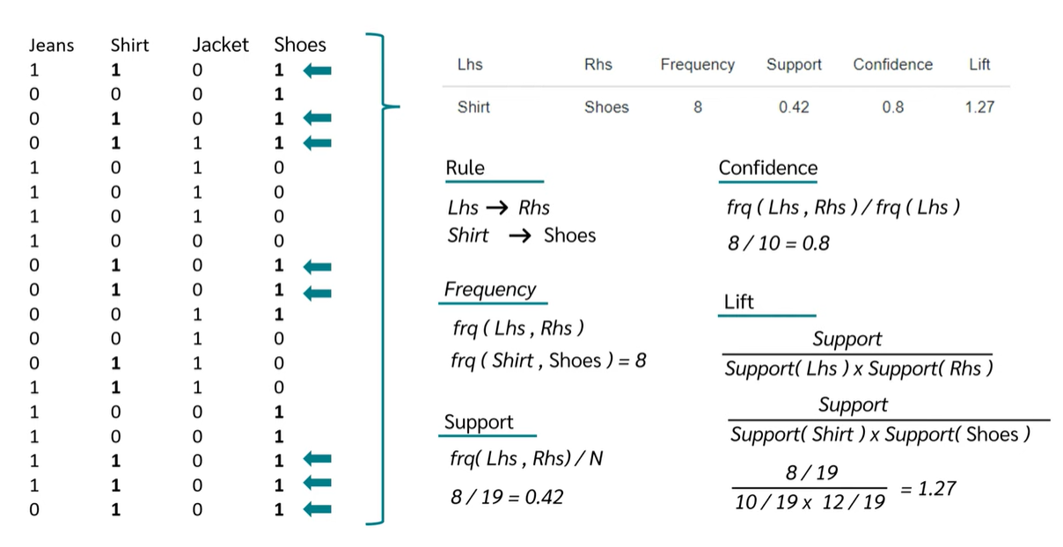
Market Basket Analysis [Association Analysis]
https://youtu.be/icGS26TS1fE?si=9rCz7XQAP8oD0v6n

Slide 27
On Apriori Algorithm
Seems to be very expensive
Level-wise search
K = the size of the largest itemset
It makes at most K passes over data
In practice, K is bounded (10).
The algorithm is very fast. Under some conditions, all rules can be found in linear time.
Scale up to large data sets

